Slide 1
Enhancing Road Safety: A ML/DL Approach to Accident Prediction and Prevention
Team Name – WUZZI-WUZZI
Team Members –
Abhijnan Maji, Adarsh Pratap Singh , Prakhar Namdeo

Slide 2
Contents
Project introduction
Data Introdcution
Data exploration insights
ML Models Used
Predicting Hotspot regions using QGIS
Computer Vision Technologies on Indian Traffic Scenerio

Slide 3
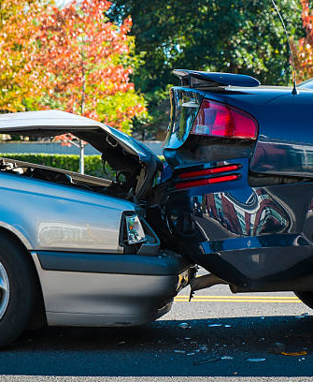
PROJECT INTRODUCTION
Identify common causes of car accidents to help prevent car accidents before they happen.
Predict severity of car accidents to help protect people after a car accident has taken place.
Using QGIS plotting heatmap.

Slide 4
DATA INTRODUCTION
The first part of our solution is built upon UK’s road accident data , that had 33 features in conjugation with a vehicle dataset for the corresponding accident records . The vehicle dataset had 24 features.
Based on the EDA performed along with feature information we selected 11 features like Engine Capacity , Daytime ,speed limit , Vehicle_manouver , Urban and Rural are , age of driver , age of vehicle , sex of driver , no. of casulaities , Road condition.

Slide 5
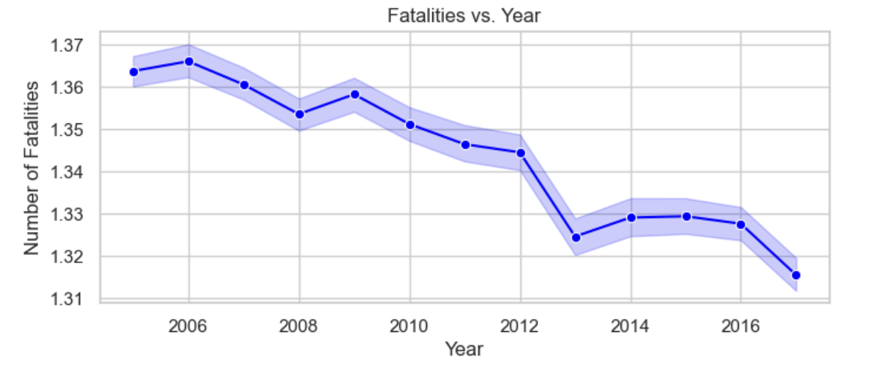
DATA EXPLORATION INSIGHTS

Slide 6
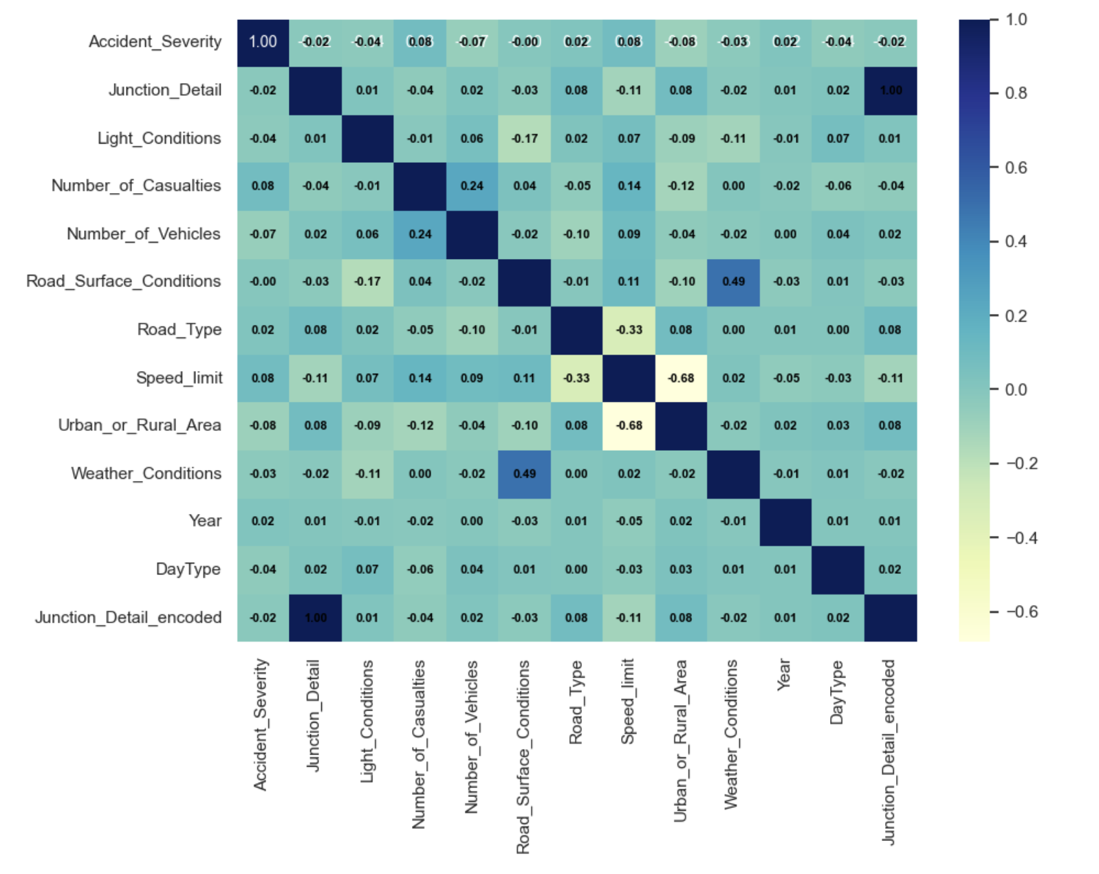
DATA EXPLORATION INSIGHTS – Correlation Matrix

Slide 7
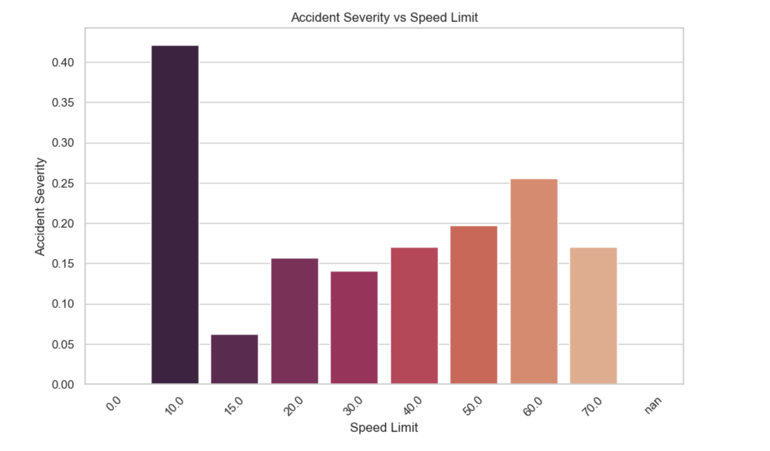
DATA EXPLORATION INSIGHTS – Speed Limit

Slide 8
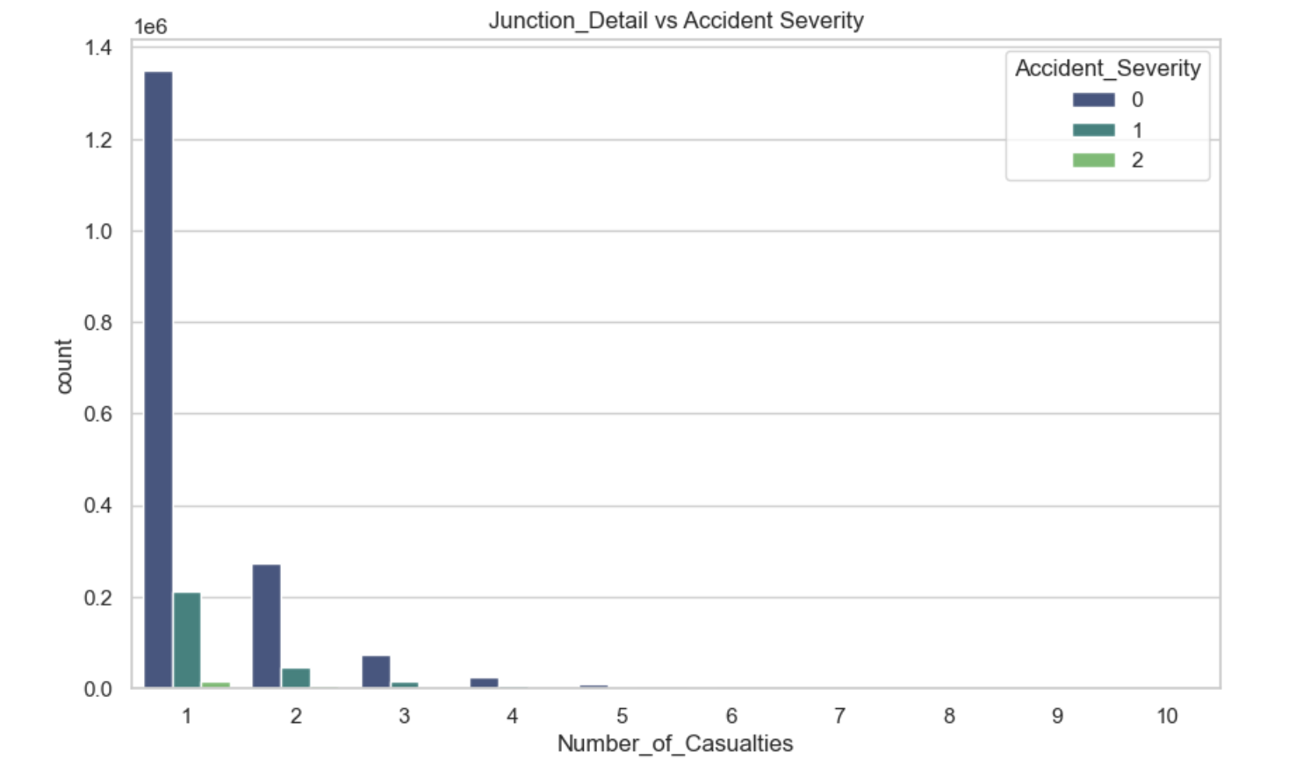
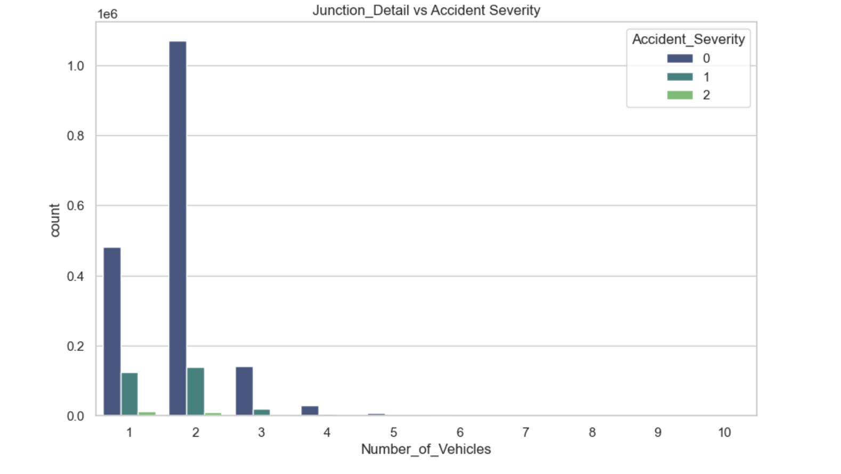
DATA EXPLORATION INSIGHTS – Junction Detail

Slide 9
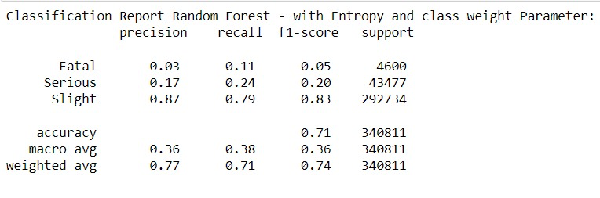
MODEL USED – RANDOM FOREST

Slide 10
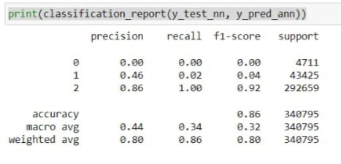
MODEL USED – NEURAL NETWORKS

Slide 11
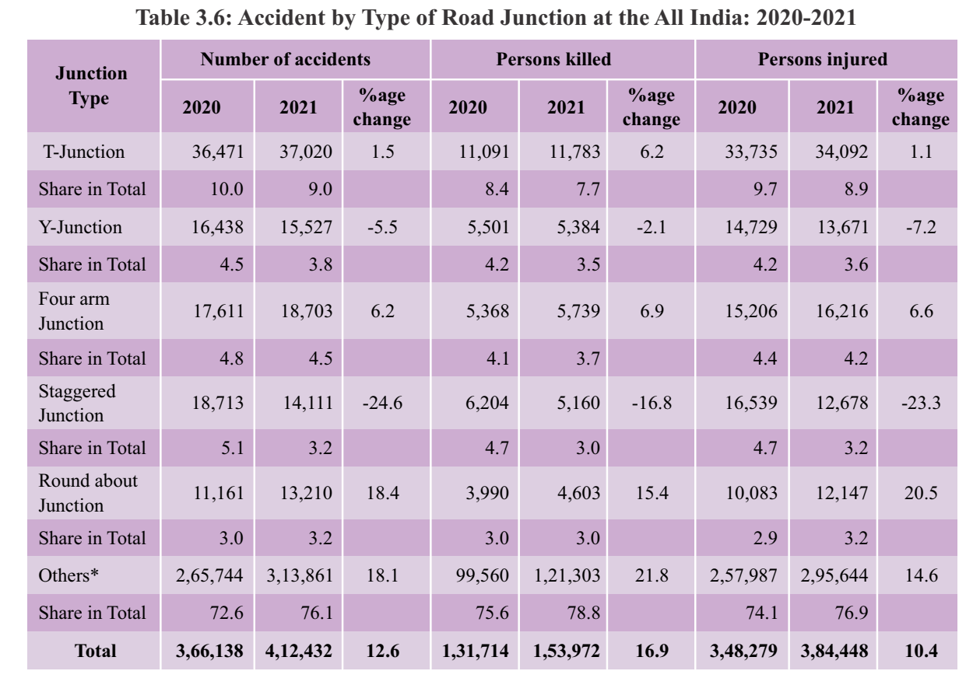
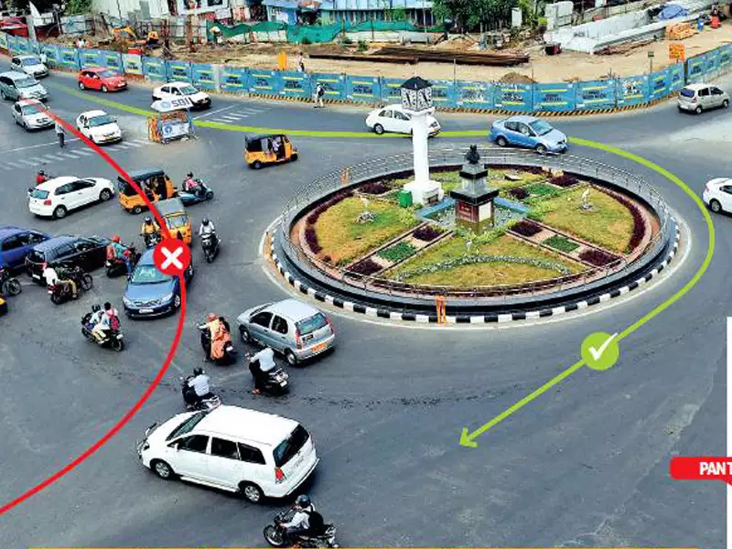
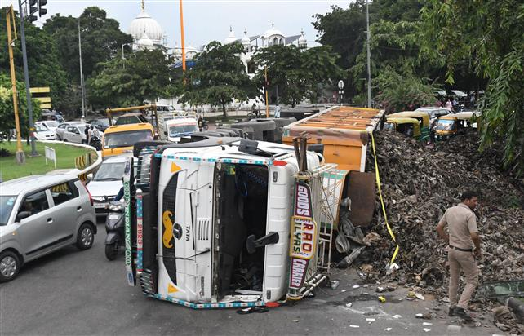
What does our data show?
(Source: Road Accidents in India - Ministry of Road Transport & Highways, 2022)
https://www.quora.com/Roundabouts-in-Chandigarh

Slide 12
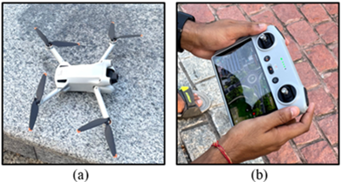
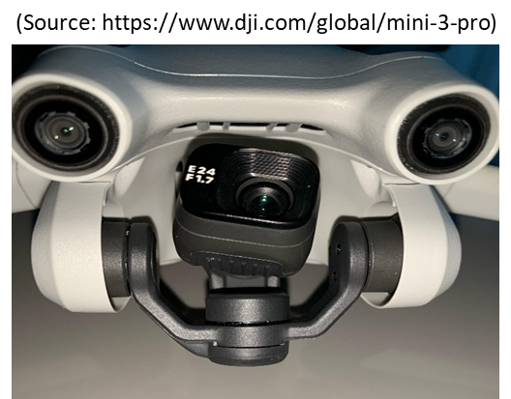
Camera deployment and video capturing
“DJI Mavic Mini 3 Pro” has been used for a series of drone flights.
It offers exceptionally reliable and 4K@60fps video data.
It is also equipped with 3-axis mechanical gimbal for video stabilization.
data was collected for multiple days in August-October 2023 during different times of the day.
The period of data collection was decided based on the time of accident information obtained from the local police.
Recording was done only when the weather was clear outside.
Drone body
Remote controller

Slide 13
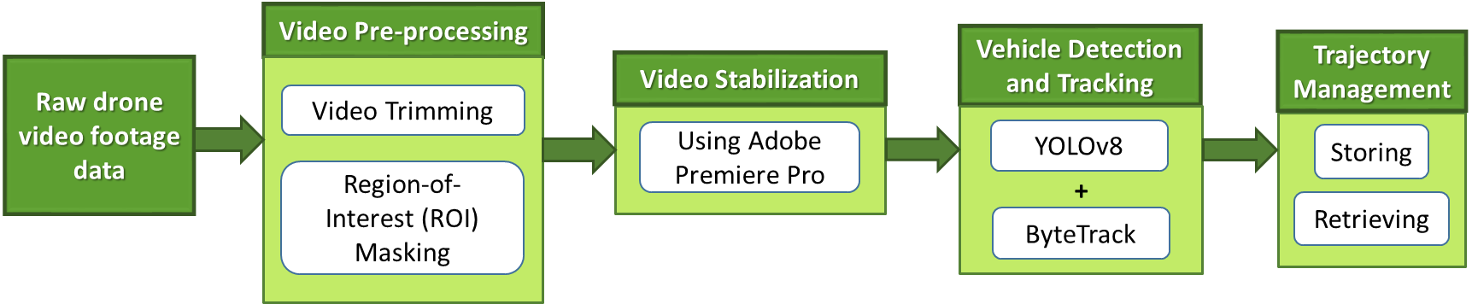
Methodology
Drone Video Processig and Analysis:
Notes:
Wrap stabilization,

Slide 14
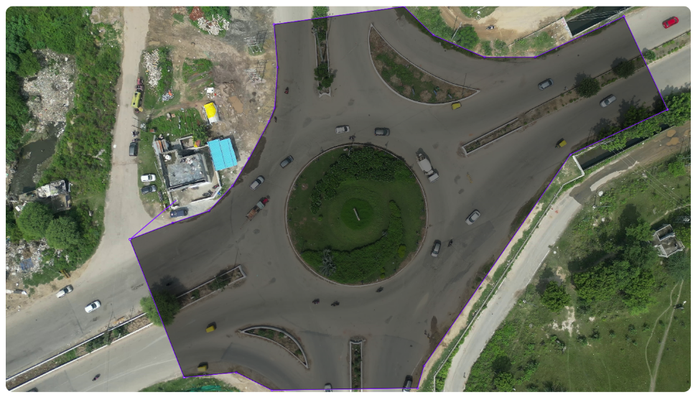
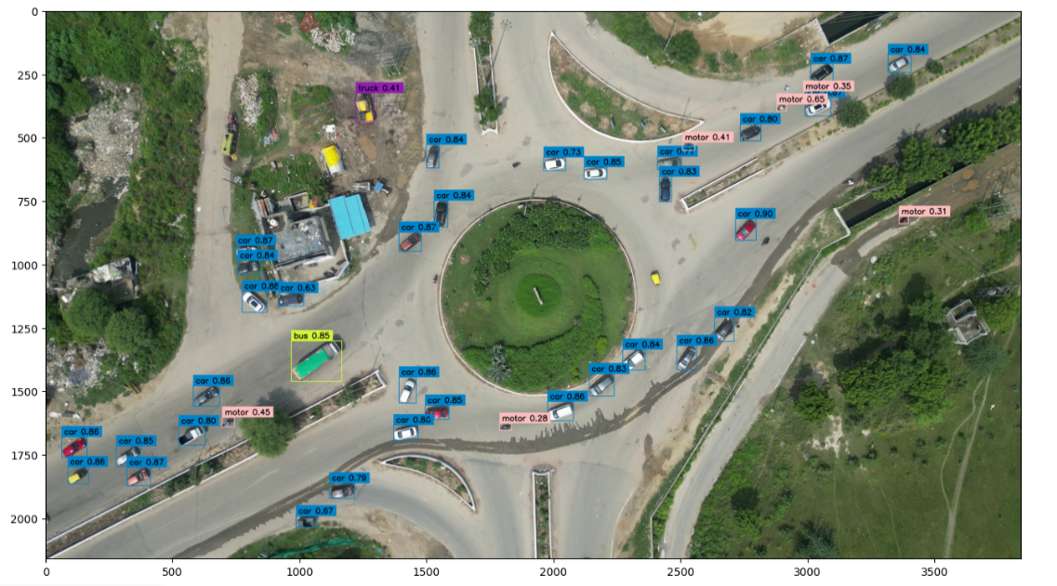
Result and discussion
Steps followed for traffic data extraction:
Setting of Region Of Interest (ROI) over the roundabout region.
Vehicles are detected using the trained detection model.
Next, they are tracked using the tracking algorithm.
Generated ROI is then masked over the frame.
Trajectories of the tracked vehicles are then used to obtain the traffic flow parameters.
Seven counter lines have been drawn to get the speed of vehicles while crossing the lines.
Speed data is then utilized to draw a speed profile.
Region Of Interest (ROI)
Detection using trained model

Slide 15
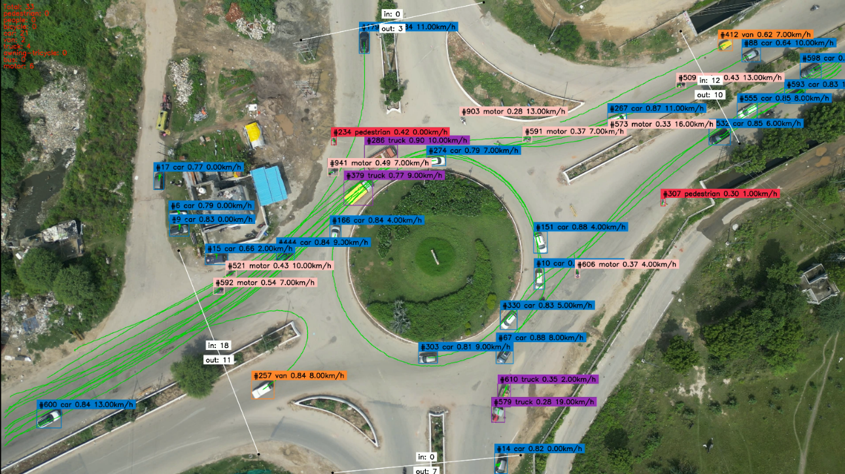
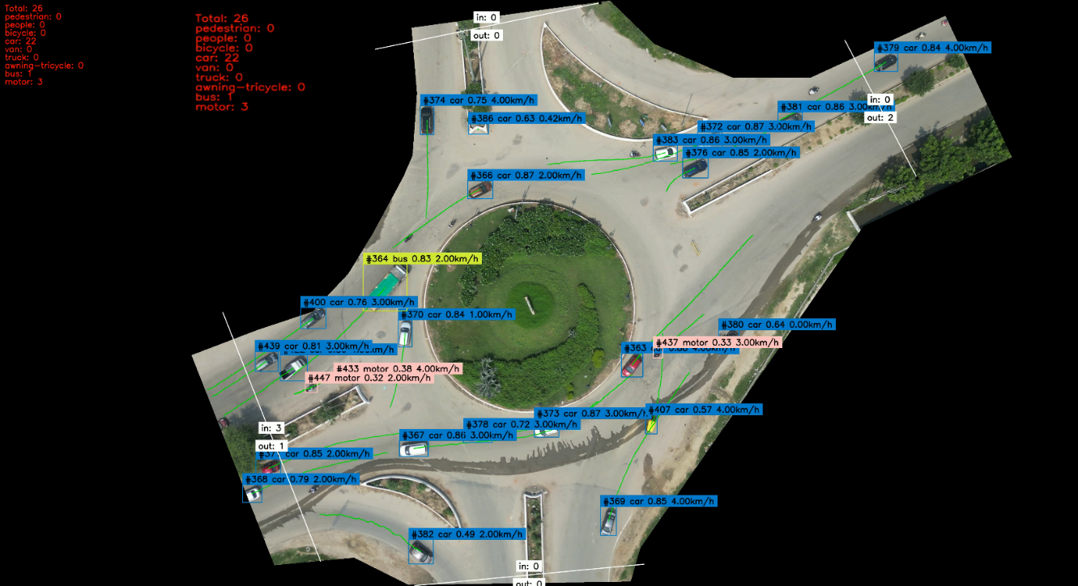
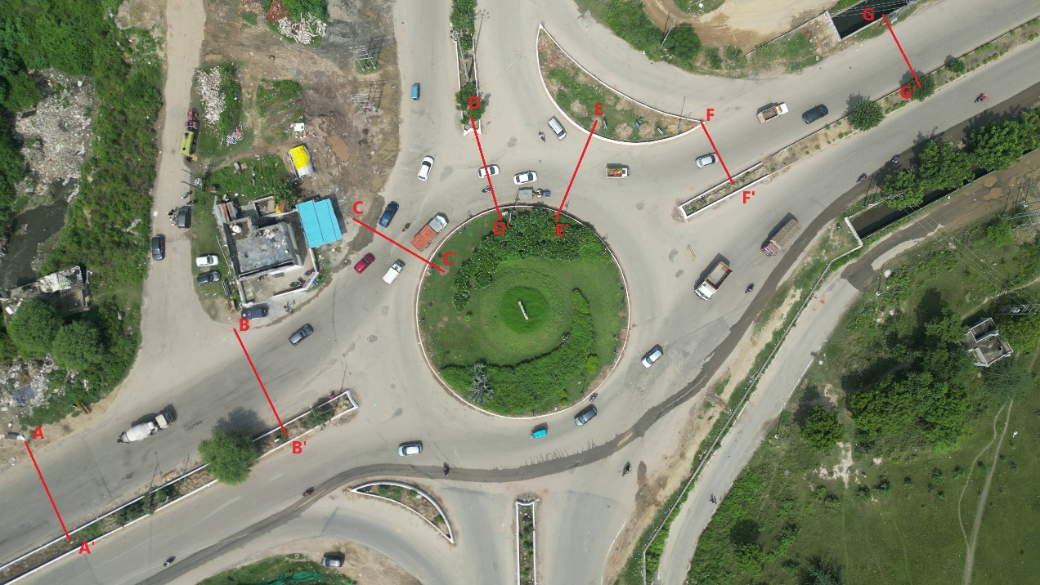
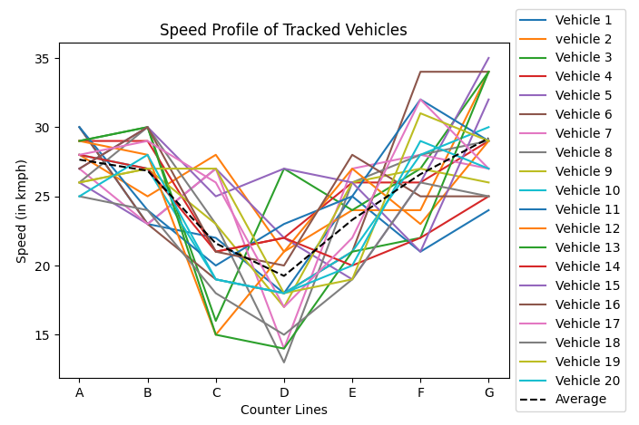
Result and discussion

Slide 16
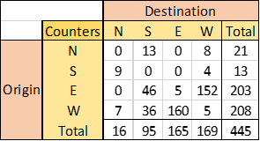
Result and discussion
Steps followed for traffic data extraction: (Contd..)
Virtual line counter is positioned on each leg to measure traffic volume.
An exact number of vehicles entering or exiting the roundabout is provided by the virtual counters.
An example OD matrix for 15 minutes data at a site in Greater Noida during morning hours is shown alongside.
From OD matrix, it is evident that, west side of the site has some activity area which attracts and produces vehicular trips.

Slide 17
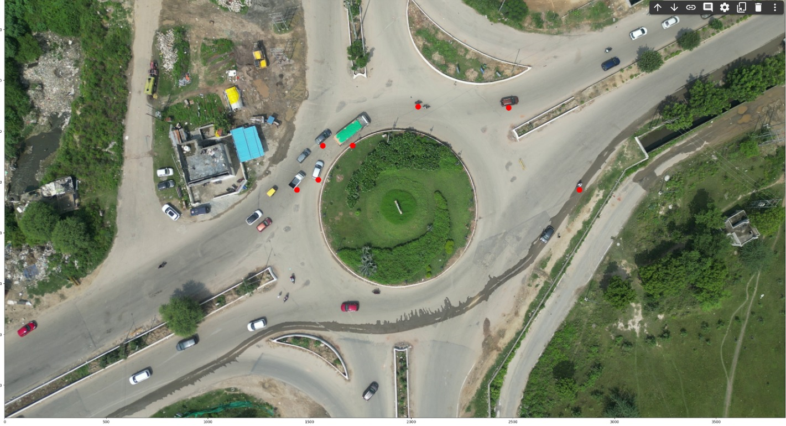
Computer Vision Technologies on Indian Traffic Scenerio
Conflict points

Slide 18
Extended Futuristic Work
Conflict analysis will help in prioritization of networks (Intersection).
Driver Warning System can be developed on real time basis.
Traffic Safety Interventions can be formulated to reduce crash numbers.
Vehicle Adhoc network can be developed utilizing prolonged surveillance system.

Slide 19
Thank You!

